Slide 1
WEB222
CSS Layouts

Slide 2
AGENDA

Slide 3
Agenda
Overview of CSS Page Layout Techniques
Overview of Legacy Page Layouts Techniques
Overview of Modern Page Layouts Techniques
CSS Grids vs Flexbox
CSS Grids
Complex Grids

Slide 4
CSS PAGE LAYOUTS

Slide 5

WHAT DOES THAT MEAN?

Slide 6
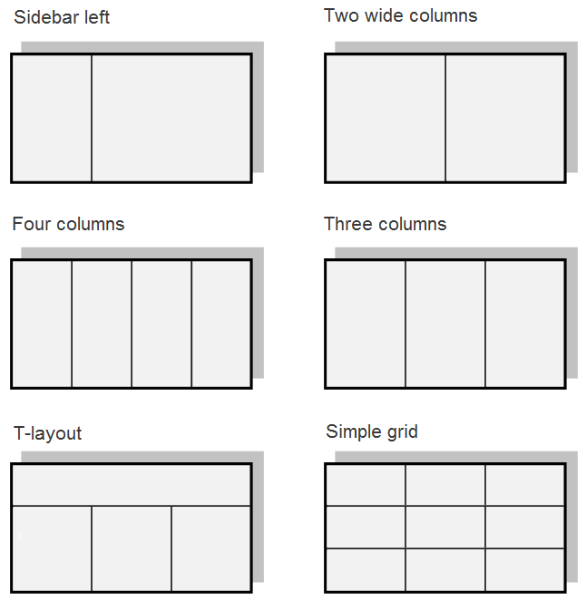
Laying out website elements into rows and columns

Slide 7
EXAMPLES:

Slide 8
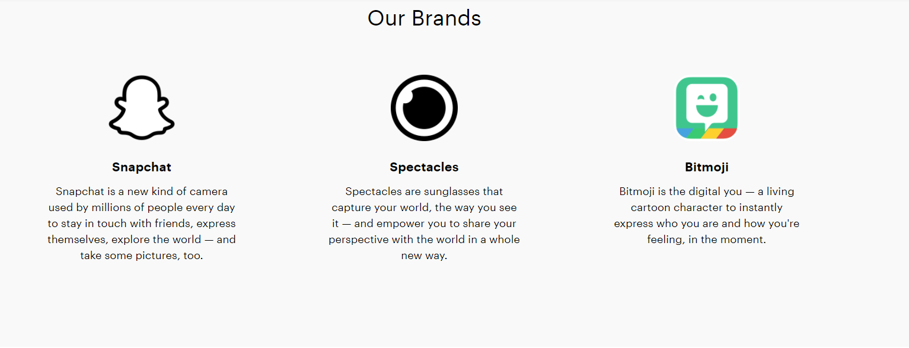

Slide 9


Slide 11
TYPES OF CSS PAGE LAYOUTS TECHNIQUES

Slide 12
CSS PAGE LAYOUT TECHNIQUES
Tables -Very Old Technique (Don’t use this,EVER)
Floats -Old Technique (Not mobile friendly)
Positioning
Flexbox - One dimensional (New Technique)
Grids- Two dimensional (Very New Technique)

Slide 13
MODERN CSS PAGE LAYOUT TECHNIQUES:
CSS GRIDS VS FLEXBOX

Slide 14
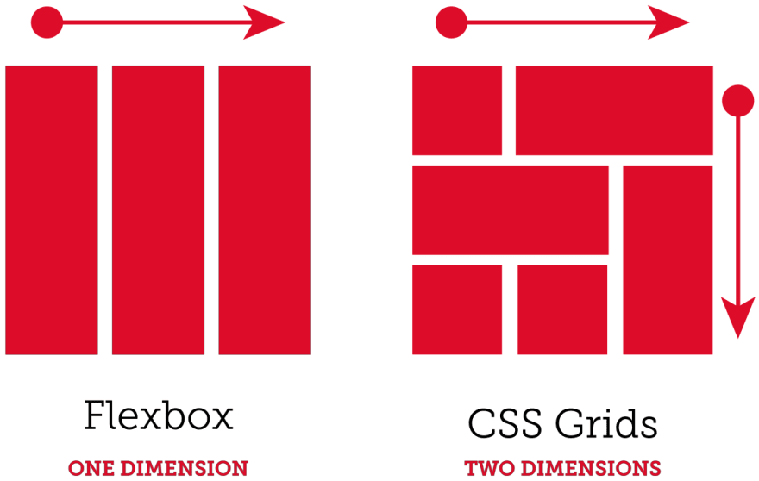

Slide 15
CSS GRIDS

Slide 16
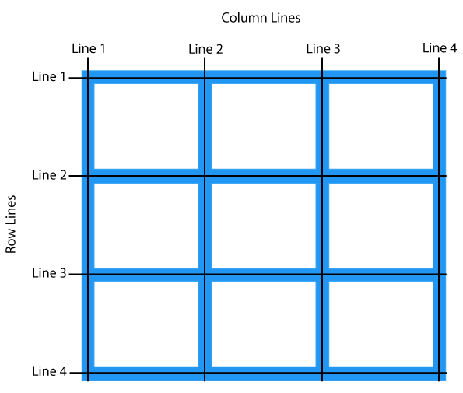

Slide 17
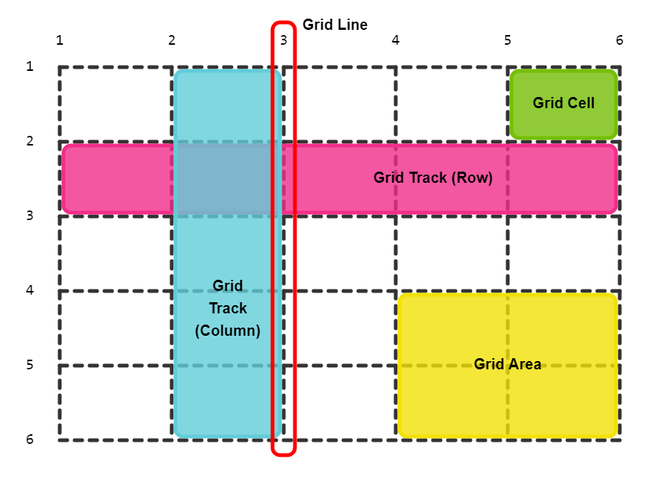

Slide 18
